Slide 1
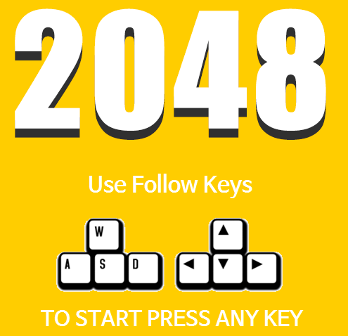
Mini Project : 2048
윤기석
Path :: \\70.12.11.160\c$\윤기석\2048.exe

Slide 2
Index
Introduction
What is..?
Why ??
Structure
Class
Algorithm
Conclusion
Comment
epilogue

Slide 3
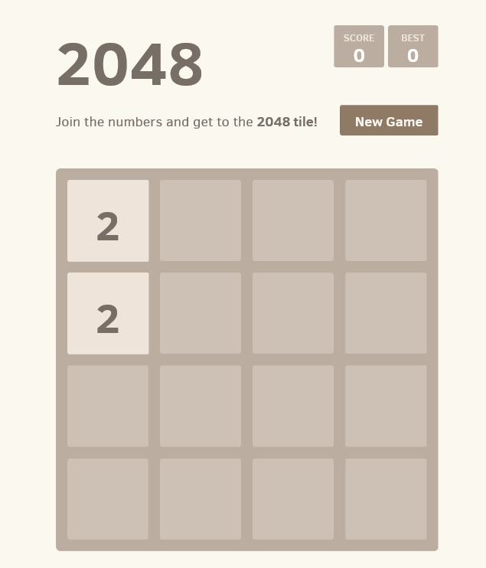
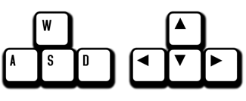
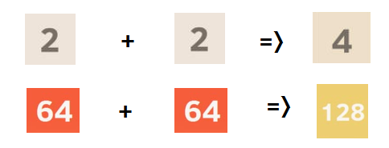
Introduction
What is..
1) Move your tiles!
2) Merge & Make more Bigger!

Slide 4
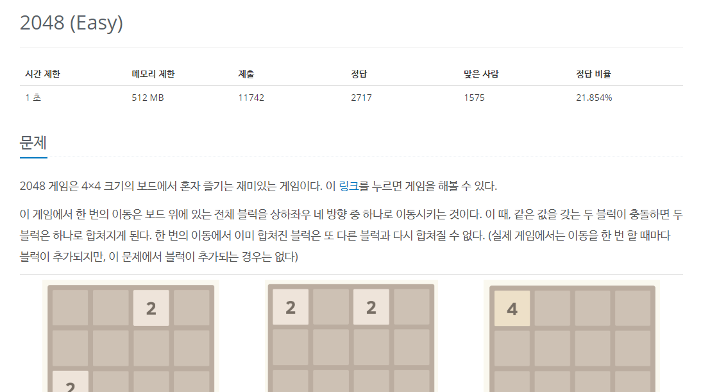


Why 2048?
Python
Algorithm

Slide 5

Structure
Class

Slide 6
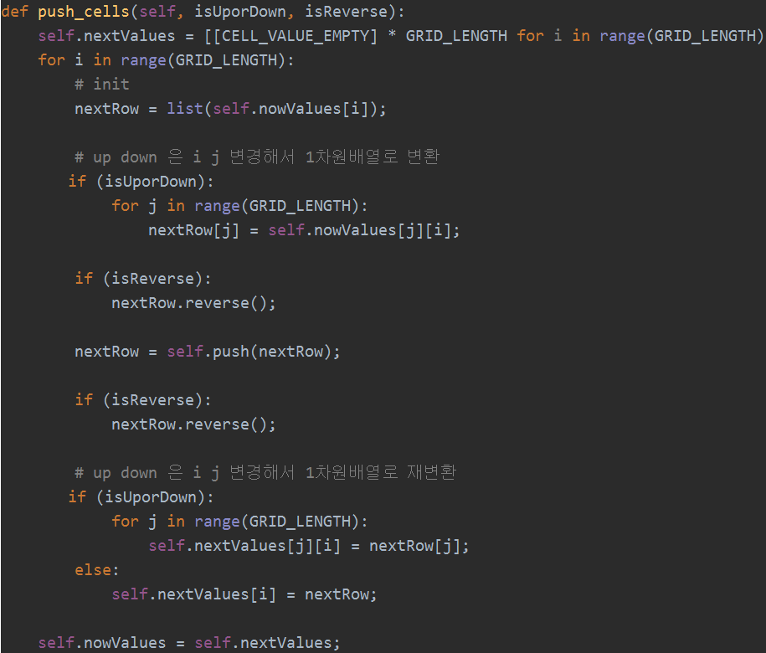
Structure
Algorithm

Slide 7
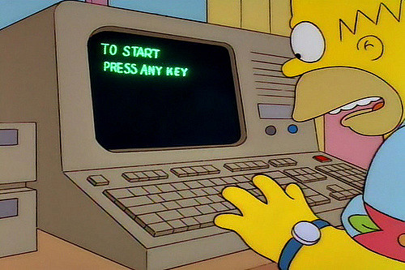
Just Play!

Slide 8
Conclusion
6 : commit log
10 hours
444 ++ 71--
257 CodeLine..

